Slide 1



Slide 2
INTRODUCTION
Excelerate is dedicated to enhancing learner engagement through a diverse array of opportunities aimed at fostering professional and personal growth.
Our mission revolves around creating pathways for learners to connect with impactful experiences, enabling them to acquire vital skills and knowledge that align with market demands.
We strive to empower individuals from various backgrounds, helping them navigate their educational journeys and achieve their career aspirations.
Purpose of the Dashboard:
The purpose of this dashboard is to provide actionable insights into learner participation and completion rates across our programs.
By analyzing trends and comparative data, we aim to identify areas of success and opportunities for improvement, ultimately supporting Excelerate's goal of maximizing learner engagement and satisfaction.

Slide 3
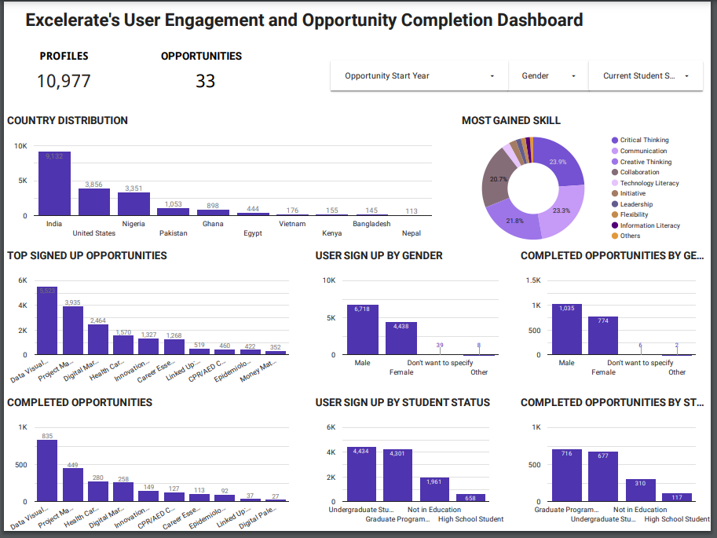
DASHBOARD OVERVIEW

Slide 4
KEY DECISIONS AND DESIGNS CHOICES
Key Decisions:
Selection of key metrics: Sign-ups, completions, demographic distributions.
Choice of visualization types: Bar charts, line graphs, pie charts.
Rationale Behind Design Choices:
Visualizations: Bar charts for monthly trends, pie charts for demographic distributions to ensure clarity.
Interactivity: Filters and drill-down capabilities to allow users to explore data dynamically.
Color Scheme: Differentiated colors for various categories to enhance readability and highlight key insights.

Slide 5

CHALLENGES FACED
Data Challenges
Handling Missing Data: Reward amounts and skill points had missing values replaced with zeros.
Data Formatting Issues: Required formatting adjustments for dates and standardizing categorical data.
Technical Challenges
Highly Skewed Data: Difficulties in statistical analysis due to skewness in reward amounts and skill points.
Project Management Challenges:
Ensuring data integrity and consistency across multiple datasets.

Slide 6
Solutions Implemented
Data Cleaning and Preparation:
Utilized 'Text to Columns' for data separation and standardized categorical entries.
Advanced Data Handling Techniques:
Applied data transformations to address skewness in numerical data.
Innovative Features:
Integrated interactive filters and dynamic charts to enhance user experience.
Developed automated data validation checks to maintain data integrity.
Team Collaboration:
Implemented agile methodologies for efficient problem-solving and project management.

Slide 7
Insights Derived
Key Insights:
Participation Trends: Significant increase in sign-ups from 2022 to 2024, with peak months in May and June.
Completion Rates: Dramatic rise in completions, especially in 2024, indicating improved engagement strategies.
Demographic Insights: Higher participation among male and graduate students, with notable engagement from India, the US, and Nigeria.
Alignment with Excelerate's Goals:
Insights support targeted marketing and tailored opportunity offerings to enhance user engagement and satisfaction.

Slide 8
Addressing Key Questions
Key Questions:
How do participation and completion rates evolve over time?
What are the differences in engagement across demographics and opportunity categories?
Dashboard Contributions:
Trend Analysis Section: Answers how metrics change over time.
Comparative Analysis Section: Provides insights into demographic and category-based differences.
Interactive Filters: Allow users to drill down into specific segments to answer nuanced questions.

Slide 9
User Interaction and Guidance
Facilitated User Interaction:
Interactive filters for time periods, demographics, and opportunity types.
Drill down capabilities for detailed analysis.
Guidance Features:
Tooltips and hover over explanations for data points.
Guided tours or onboarding tutorials for first time users.
Clear labeling and legends to ensure ease of understanding.

Slide 10
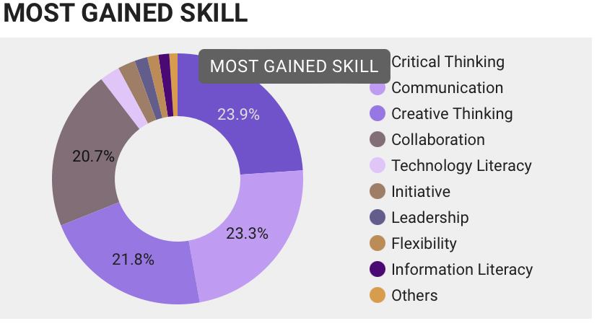
MOST GAINED SKILL
VISUAL HIGHLIGHTS
This pie chart visualizes the distribution of the most gained skills among users. The top three skills are; Critical Thinking (23.9%), Communication (23.3%), Creative Thinking (21.8%)
These are closely followed by Collaboration (20.7%), while other skills such as Technology Literacy, Leadership, and Flexibility account for smaller percentages. The chart highlights a strong focus on essential soft skills in user engagement.

Slide 11
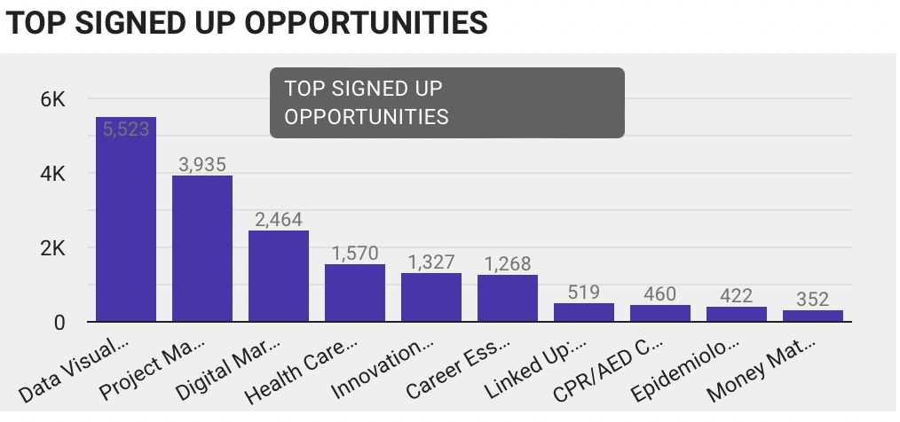
Monthly Sign-Up Trends
VISUAL HIGHLIGHTS
This bar chart shows the top opportunities users have signed up for. The “Data Visualization” opportunity is the most popular, with 5,523 sign-ups, followed by “Project Management” with 3,935 and “Digital Marketing” with 2,464. Other opportunities, like “Career Essentials” and “Health Care,” follow at a lower scale. This chart helps identify which learning areas are attracting the most interest.

Slide 12
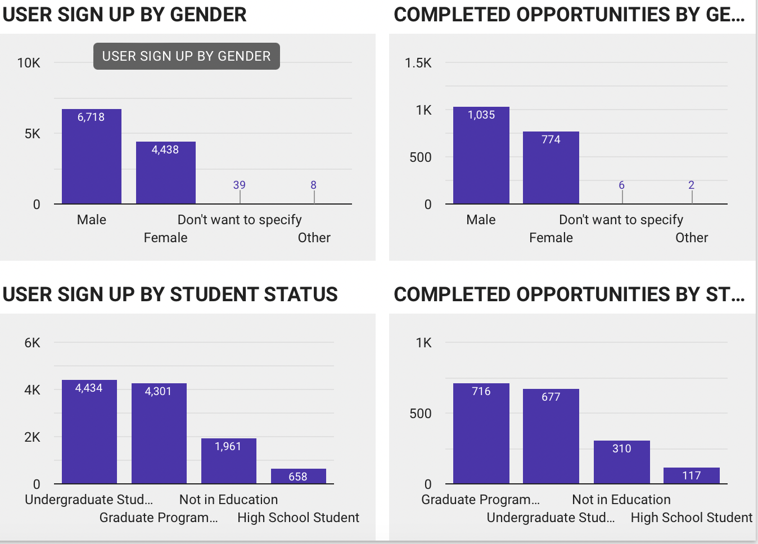
Demographic Distribution
VISUAL HIGHLIGHTS
This chart shows user sign-ups and completed opportunities based on gender and student status. Most sign-ups are from males (6,718), followed by females (4,438), with minimal participation from "Don't want to specify" (39) and "Other" (8).
In terms of student status, the highest sign-ups come from undergraduate (4,434) and graduate students (4,301), while users "Not in Education" and high school students account for 1,961 and 658 sign-ups, respectively. Graduate students completed the most opportunities (716), followed closely by undergraduates (677), with lower completions from those not in education (310) and high school students (117).

Slide 13
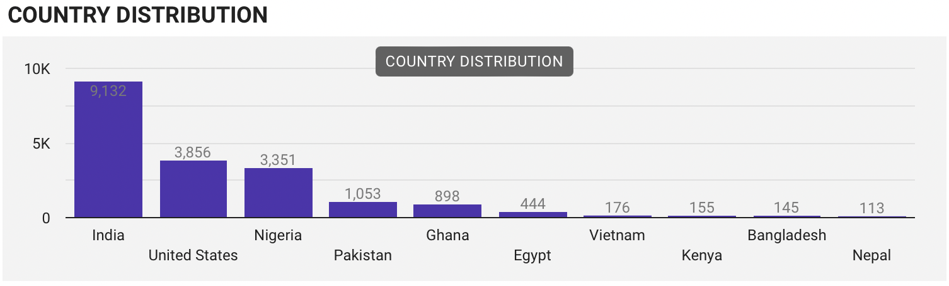
Geographic Distribution
VISUAL HIGHLIGHTS
The bar chart represents the geographical distribution of users across different countries. India leads with the highest number of users (9,132), followed by the United States (3,856) and Nigeria (3,351). Other countries like Pakistan, Ghana, and Egypt have significantly smaller user bases, with less than 1,500 users each. This chart emphasizes the platform’s primary user markets.

Slide 14
Impact on Decision Making
Strategic Impact:
Informed marketing strategies targeting underrepresented demographics.
Optimization of opportunity offerings based on popularity and completion rates.
Enhanced resource allocation to regions with high engagement potential.
Organizational Value:
Data driven insights lead to improved learner engagement and satisfaction.
Facilitates proactive identification of trends and potential challenges.
Supports continuous improvement and strategic planning for Excelerate.

Slide 15
Conclusion
Summary of Key Points:
Successful integration of EDA and trend analysis to create a comprehensive dashboard.
Significant growth in participation and completion rates aligned with strategic goals.
Identification of key demographics and geographic areas for targeted strategies.
Final Thoughts:
The dashboard is a powerful tool for Excelerate to drive engagement and enhance learner outcomes.
Ongoing improvements and data monitoring will further amplify its effectiveness.

Slide 16
Recommendations
Targeted Marketing Campaigns:
Increase female participation through tailored campaigns and showcasing role models.
Promotional Events:
Leverage peak engagement months (May, June) with webinars and workshops.
Customized Opportunities:
Expand internships and technical courses based on high completion rates.
Geographic Outreach:
Focus on regions with lower participation like Bangladesh and Nepal through partnerships.
Engagement Initiatives:
Develop programs for non-traditional students to broaden participation.
Enhanced Support Systems:
Implement mentorship programs to boost completion rates and user satisfaction.

Slide 17
